Slide 1



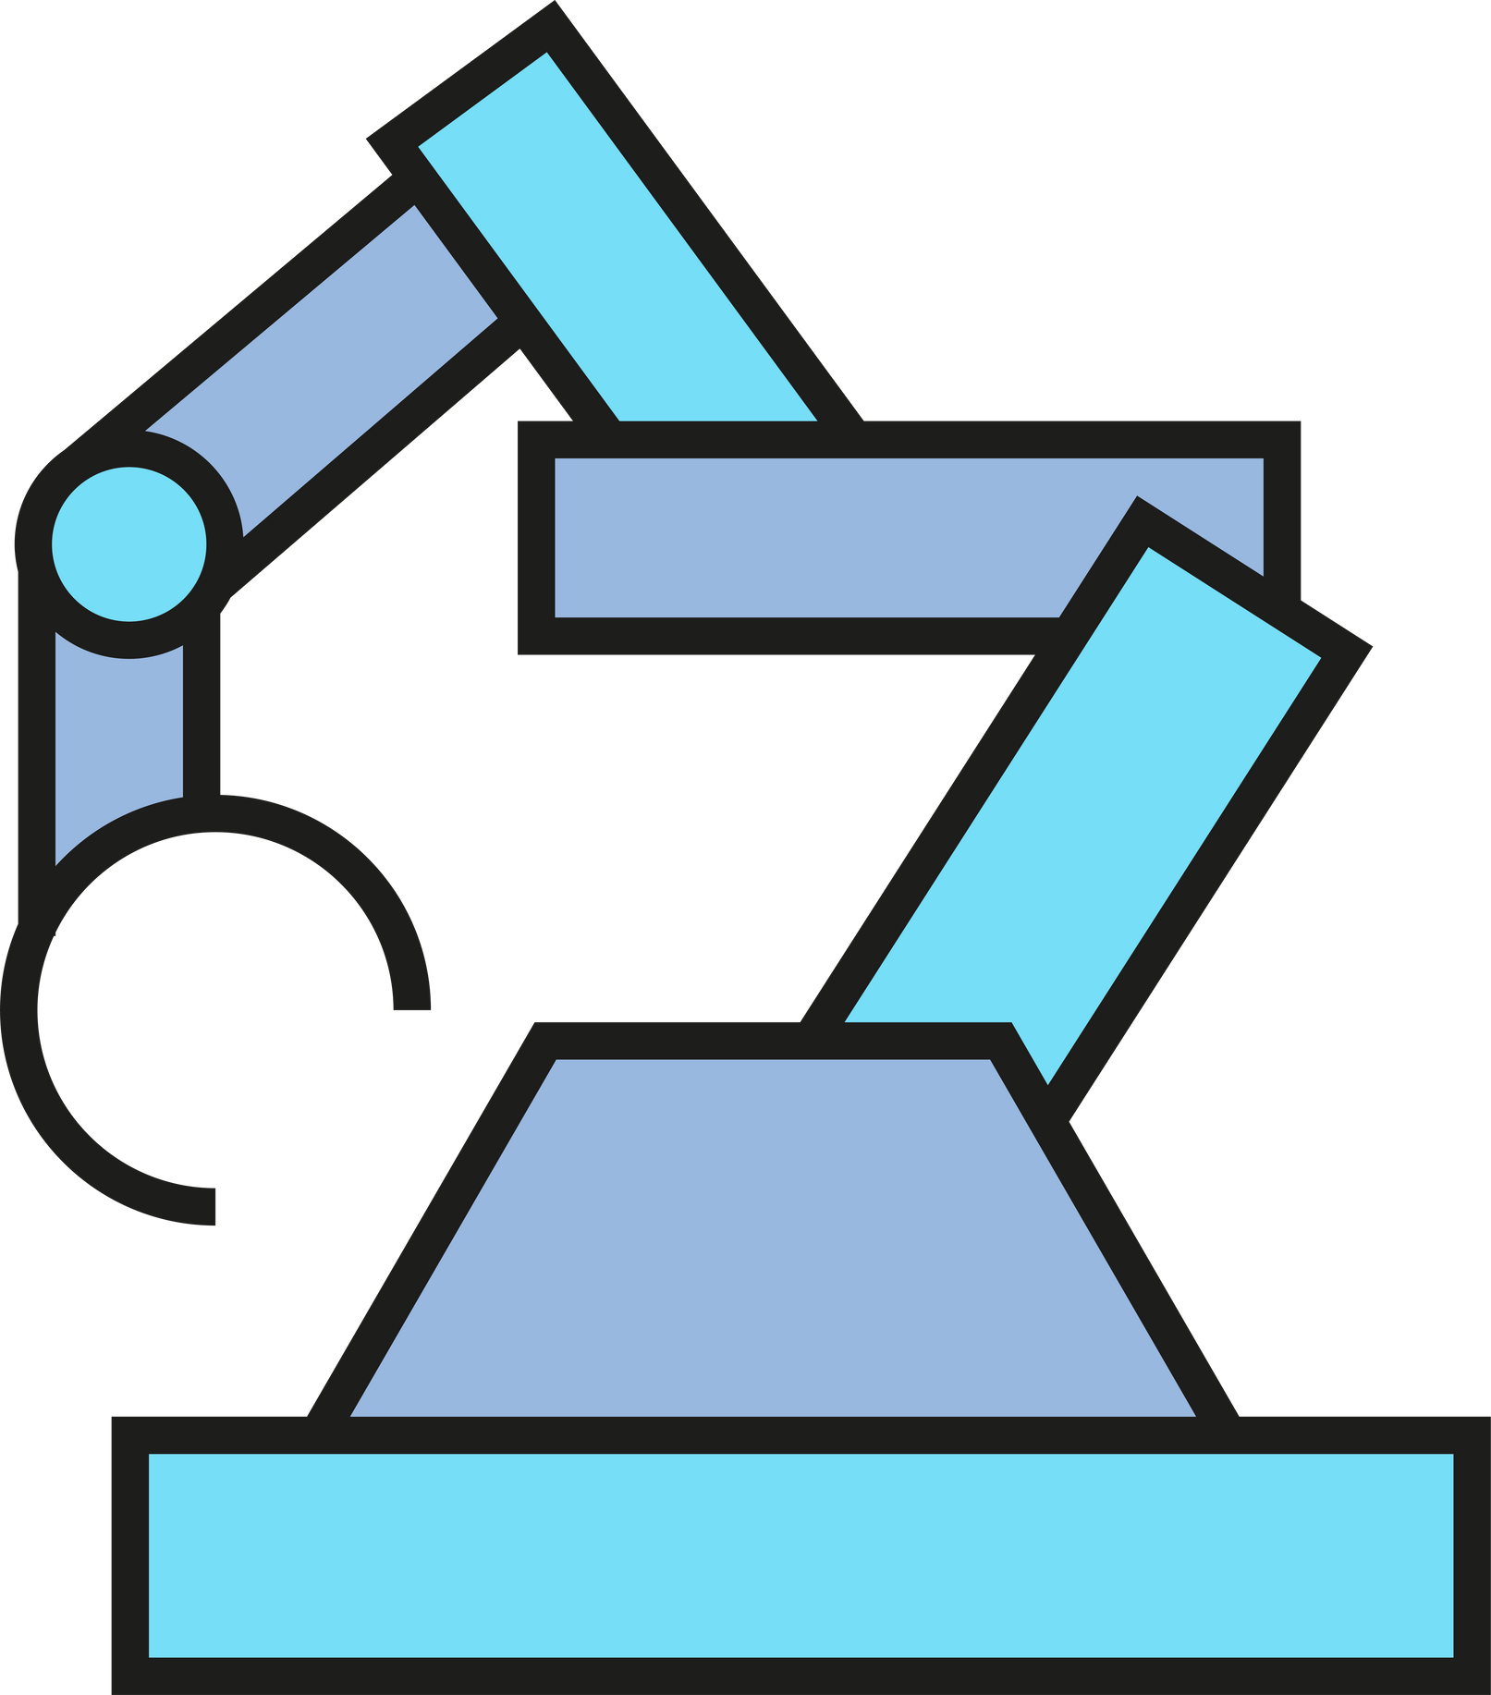


Robotics Project
Federico Gritti, Kadir Özden, Fanni Véh

Slide 2
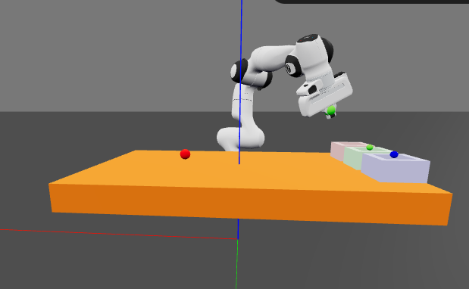

Introduction
Goal:
Sorting berries by colour on a table and placing them in the corresponding coloured box

Slide 3

What we have done
Core Tasks:
  Create all the necessary classes and methods to create reusable code.
  Create an algorithm to identify and sort objects (e.g., colored cubes) into designated bins based on their color.
  Use the Panda robot manipulator and assume the color of the objects is known.
1
For Each Detected Object:
  Compute the picking position (pick) and the placing position (place) based on the object’s color.
  Use inverse kinematics to obtain the robot configurations (q_pick and q_place).
2

Slide 4

What we have done
Control Strategies
  Implement joint-space trajectory interpolation: move from pick to place positions using interpolated joint trajectories between q_pick and q_place. (has not been implementted yet)
  Implement resolved-rate motion control: use Cartesian velocity control to reach pick and place poses smoothly.
3
Analysis
  Plot and compare trajectories for both strategies (joint and Cartesian space).
  Analyze end-effector path smoothness.
  Analyze execution time.
  Analyze sorting accuracy.
4

Slide 5
Extra steps
Mock a camera so that the robot has to find the location and color of the spheres based on visual input. (NOT FEASIBLE)
+1
Putting cylinders between the berries and the boxes and create vectors of repulsion around these objects, this would make the robot sense the obstacles. We had the idea to make it even more complicated and gamified by letting the user control the position of the cilinder (trying to create a crash)
+2

Slide 6
Showcase!

